Slide 1

Telephone: W (402) 915-3007 M (308) 325-2832
E-mail: Teri@envisionsuccessinc.com
Website: envisionsuccessinc.com
Teri K Whittington

Slide 2
Ice Breakers and Adding Value!
Steak
  801 Chophouse @1403 Farnam St.
Speakeasy (Just for fun!)
  Wicked Rabbit @1508 Harney St.
Burgers
  Block 16 @1611 Farnam St
  Dinker’s Bar & Grill @2368 S. 29th
  Omaha Tap House @1403 Farnam
Italian
  Cibo Vino @1101 Jackson St.
Fish & Chips
  Wilson & Washburn
  @1407 Harney St.
Teri’s Favorite
  Brushi Bistro & Bar
  @711 N. 132nd St

Slide 3


Power of Communication in Business
Learn to say the same thing in a different way
Convinced against your will you’re of the same opinion still

Slide 4
Wait, What???
              Identify the Correct question to ask:
                WHAT
                WHO
                HOW
                WHY

Slide 5

The Benefits
Identity how people tend to make decisions
Enhance ability to communicate more effectively by understanding another’s point of view
Learn how various personality styles can cause people’s responses
Identify communication/personality styles
Recognize negative consequences of pushing others to an extreme
Learn how the various types influence an individual’s perspective

Slide 6
WHAT WORDS MATTER TO WHOM??
Building codes, insulation pro, handyman, cost, inspection, contractor, state licensed, R-value, fiberglass insulation, foam insulation, warranty, thickness, sound dampening, efficiency, rock and slag wool, cellulose, specifications, staples, screws, tapes, compressors, vapor barrier, increased energy, spray insulation, blown insulation, coatings, polyurea, sealant, lifespan, settling, lb. per cu. ft. ratio, acoustic, low dust, fire resistance, toxicity, thermal rating, sustainable……………………….

Slide 7

The Puzzle

Slide 8
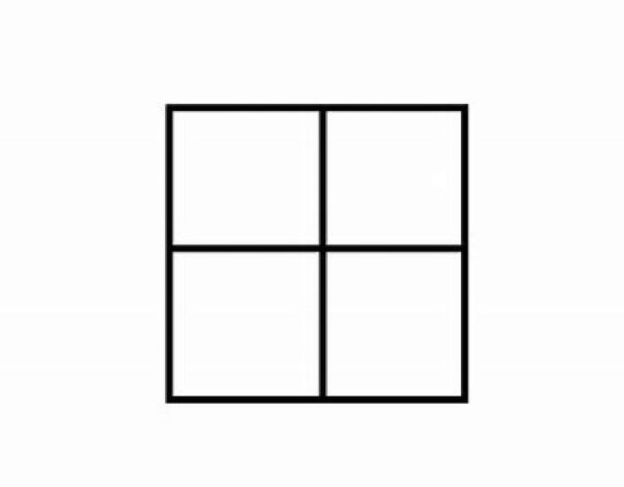

Solving the Puzzle

Slide 9

The Pencil Parable
Placed in Someone’s Hand
Sharpening Occurs
Mistakes Happen
Core Value is Not on the Outside
Leaves a Mark

Slide 10
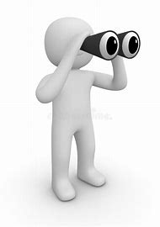

TWO KEY PERSPECTIVES AND OBSERVATIONS
OBSERVATION #1:
  The Pace Perspective
OBSERVATION #2:
  The Priority Perspective

Slide 11

PACE
Outgoing ⭢ Extroverted
Active ⭢ Dives In
-------------------------------
Reserved ⭢Introverted
Passive ⭢Takes time Before Diving In

Slide 12

PRIORITY
Task
Get Things Done
Accomplishment
People
Feelings
Interactions

Slide 13
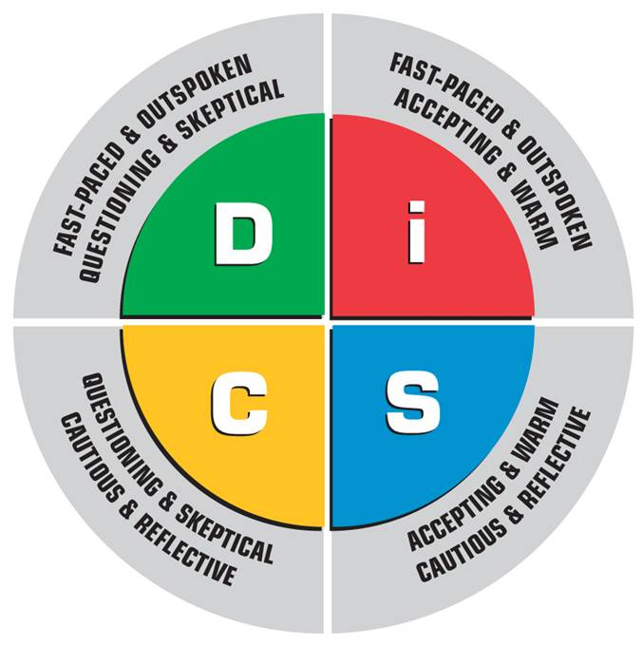
DISC MODEL
!
★
+
?

Slide 14
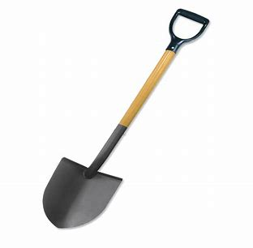
DIGGING DEEPER

Slide 15
The Dominant D is Task Driven (10-15% Of Population)
D Words | People | Profession | Are/Can (Be)
Dominant Direct Determined Decisive Dogmatic Diligent Doer Defiant | Donald Trump Bobby Knight Jeff Bezos Vladimir Putin Elon Musk Gordon Ramsey Benjamin Netanyahu Miss Piggy & Oscar | Lawyers Military/Special Forces Race Car Drivers Athletes Business Owners Developers Executives | Goal-Oriented Intense Self-Confident Firm Decision Makers Seek Leadership Productive Independent
*Target: Ready…Fire…Aim! *Motto: Go for it! *Question: What? *Need: Challenge & Results
Non-Verbal Cues: firm handshake, big gestures, finger pointing, fast-moving/displays impatience, leans forward

Slide 16
The Inspiring I is People Driven (25-30% Of Population)
I Words | People | Profession | Are/Can (Be)
Inspiring Influencing Interesting Impressionable Interested in People Imaginative Impulsive Illogical | Bruce Springsteen Richard Branson Robin Williams Steve Martin Blake Shelton Jim Carrey Carol Burnett Elmo & Ernie | Actors Sales-People Public Speakers Politicians Teachers Comedians Preachers Auctioneers | Fun to Watch Great Starters Quickly Bored Likeable Prone to Exaggerate Easily Excitable Have Lots of Friends May Need to Focus
*Target: Ready…Aim…Talk! *Motto: Lighten Up! *Question: Who? *Need: Recognition
Non-Verbal Cues: energetic, poised, animated facial expressions, contact-oriented, often looks distracted, charming

Slide 17
The Supportive S is People Driven (30-35% Of Population)
S Words | People | Profession | Are/Can (Be)
Supportive Steady Secure Serve Submissive Shy Sentimental Overly Sensitive | Princess Diana David Ortiz Bob Marley Florence Nightingale Matt Damon Pope Francis Sally Field Kermit & Big Bird | Supervisors Managers Technicians Counselors Diplomats Pharmacists Real Estate Agents Veterinarians | Agreeable Compassionate Nicest People in World Loyal Friends Considerate of Others Take Their Time Are Sentimental Want Appreciation
*Target: Ready…Ready…Ready… *Motto: All for 1 & 1 for All *Question: How? *Need: Reassurance
Non-Verbal Cues: Slower-moving body language, intermittent eye contact, gentle handshake, exhibits patience

Slide 18
The Cautious C is Task Driven (20-25% Of Population)
C Words | People | Profession | Are/Can (Be)
Cautious Competent Calculating Critical Thinking Conscientious Correct Consistent Cold | Steve Jobs Leo DiCaprio Warren Buffett Alfred Hitchcock Stephen Hawking Eric Clapton Bill Nye (Science Guy) Bert & Count von Count | Accountants Architects Pilots Physicians Professors Dentist Engineers Scientists | Focused on Excellence Dedicated to the Task Logical Attentive to Details Have Lots of Questions Want to Understand Think in Concepts Might Seem Uncaring
*Target: Ready…Aim…Aim… *Motto: If Something can go wrong, it will *Question: Why? *Need: Quality Answers
Non-Verbal Cues: few gestures, few facial expressions, non-emotional, formal and conservative, slower moving

Slide 19

KEY CONCEPT…
STRENGTHS
Pushed to an Extreme Become
WEAKNESSES

Slide 20
D STRENGTHS
*Strong-Willed
*Determined
*Independent
*Optimistic
*Practical
*Productive
*Decisive
*Leader
*Confident
On a Good Day | On a Bad Day
Courageous | Reckless
Quick to Respond | Rude
Goal-Oriented | Impatient
Results-Oriented | Pushy
Deliberate | Dictatorial
Self-Confident | Conceited
Direct | Offensive
Self-Reliant | Arrogant
Straightforward | Abrasive
Competitive | Ruthless

Slide 21
I STRENGTHS
*Friendly
*Compassionate
*Carefree
*Talkative
*Outgoing
*Enthusiastic
*Warm
*Personable
*Fun
On a Good Day | On a Bad Day
Optimistic | Unrealistic
Persuasive | Manipulative
Excited | Emotional
Communicative | Gossip
Spontaneous | Impulsive
Outgoing | Unfocused
Expressive | Excitable
Involved | Directionless
Imaginative | Daydreaming
Warm/Friendly | Purposeless

Slide 22
S STRENGTHS
*Calm
*Dependable
*Easygoing
*Trustworthy
*Efficient
*Practical
*Conservative
*Diplomatic
*Humorous
On a Good Day | On a Bad Day
Relaxed | Lacking Initiative
Reliable | Dependent
Cooperative | Used By Others
Stable | Indecisive
Good Listener | Uncommunicative
Single-Minded | Inflexible
Steadfast | Resistant to Change
Softhearted | Easily Manipulated
Systematic | Slow
Amiable | Resentful

Slide 23
C STRENGTHS
*Gifted
*Analytical
*Sensitive
*Perfectionistic
*Aesthetic
*Idealistic
*Loyal
*Self-Sacrificing
*Thorough
On a Good Day | On a Bad Day
Orderly | Compulsive
Logical | Critical
Intense | Unsociable
Curious | Prying
Teachable | Easily Offended
Cautious | Fearful
Correct | Inflexible
Questioning | Doubtful
Conscientious | Worrisome
Precise | Picky

Slide 24
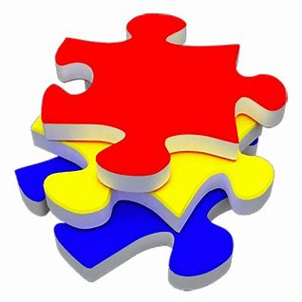

OK…..NOW WHAT???
Putting the
Puzzle Pieces
in Place

Slide 25

D Types Like…. Activity Bigness Challenge Competition Debate Doing Things | D Types Don’t Like… Indecision Talk Without Action Activities Without a Goal Slow Activities Unproductive People Being Told What to Do
WANT YOU TO BE….
*Quick *Confident *Productive *To the Point *Specific *Driven

Slide 26

I Types Like…. Exposure to People Lots of Activity Making People Laugh Short-Term Projects To Be On The Go Prestige | I Types Don’t Like… Being Ignored Being Ridiculed Looking Bad Being Isolated Doing Repetitive Tasks Constraints
WANT YOU TO BE….
*Fun *Responsive *Stimulating *Positive *Upbeat *Enthusiastic

Slide 27

S Types Like…. Peace Stabilizing Things Helping Others Friendly Environments To Finish The Job Teamwork | S Types Don’t Like… Insensitivity Misunderstandings Surprises Intense Conversation Sarcasm Being Pushed
WANT YOU TO BE….
*Kind *Pleasant *Caring *Patient *Understanding *Gentle

Slide 28

C Types Like…. Consistency Detail Excellent Work Creativity Perfection Getting It Right | S Types Don’t Like… Being Criticized Ambition With No Plan Mistakes Mediocrity Illogical Changes Unnecessary Interruptions
WANT YOU TO BE….
*Open-Minded *Accountable *Structured *Accurate *Analytical *Reasonable

Slide 29
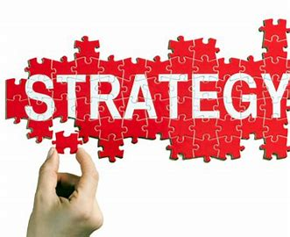

Slide 30
The Dominant D Type (Dealing with the Task)
D to D
  Struggles – Power Struggles. Neither of you wants to back down or compromise.
  Strategies – Don’t force issues. Allow person to have choice and control. Don’t argue or give ultimatums.
D to C
  Struggles – Your focus is getting things done NOW, and their focus is getting things done RIGHT. Your desire to control may discourage a cautious person.
  Strategies – Don’t rush or push. Don’t criticize. Be patient. Be willing to answer their questions and provide answers.

Slide 31
The Dominant D Type (Dealing with the Relationship)
D to I
  Struggles – This person does not share your drive to complete tasks. This person’s focus is on relationships and fun rather than on tasks.
  Strategies – Realize this person usually doesn’t focus on one thing, but on many things. Allow them to talk, express themselves. Make things FUN! Be positive and express approval to them.
D to S
  Struggles – Coming on too strong can be intimidating to them. Never confuse their kindness for weakness.
  Strategies – Be patient and willing to spell things out, step-by-step. Calmly communicate. Relax. Express appreciation often.

Slide 32
The Inspiring I Type (Dealing with the Task)
I to D
  Struggles – You may find the other person to be too controlling, while you are too permissive. You are more social; they are more task-driven.
  Strategies – Be more direct and get to the point. Don’t be afraid of confrontation; expect it, and do not take it personally. Work first, THEN fun.
I to C
  Struggles – Your differences can lead to misunderstandings. You like to talk, they like time alone. It is easy to miss their indirect way of sharing concerns.
  Strategies – Tone down your emotional reactions. Be factual and objective. Don’t rush or push. Be specific; they’ll take you literally.

Slide 33
The Inspiring D Type (Dealing with the Relationship)
I to I
  Struggles – Both of you live enthusiastically and may compete for attention. Both of you are impulsive which may lead to lack of follow-through.
  Strategies – Remember to listen to each other. When working on tasks, keep each other accountable. Give sincere recognition of their ideas and abilities.
I to S
  Struggles – Most struggles are related to pace. You like FAST, they prefer calm, quiet, and predictable.
  Strategies – Slow down your approach. Tone down your enthusiasm. Be sincere with praise. Do not embarrass them in public.

Slide 34
The Supportive S Type (Dealing with the Task)
S to D
  Struggles – This person can exhaust you by being controlling and expecting instant action. You can become stressed, and they can become impatient.
  Strategies – Don’t take it personally when this person takes action without you. Be more firm, direct, decisive and action/results-oriented.
S to C
  Struggles – You tend to be sensitive while they tend to be critical. Your ‘feelings’ nature can clash with their ‘logic’ nature.
  Strategies – Don’t take their questioning, critical nature personally. Be willing to give in-depth answers. Don’t’ push them into closeness.

Slide 35
The Supportive S Type (Dealing with the Relationship)
S to I
  Struggles – Biggest struggle is pace. This person likes excitement and activity, but you prefer slow and calm. Their large social circle may overwhelm you.
  Strategies – Be more outgoing and energetic. Set some limits; don’t feel pressured by their energy. Don’t take it personally if they seem to give you fragmented attention.
S to S
  Struggles – The main struggle is in communication. You both talk indirectly and neither of you likes hard decisions, conflict, or tension.
  Strategies – Be willing to take initiative and be more decisive. Realize some conflict and change is healthy. Honestly share your feelings.

Slide 36
The Cautious C Type (Dealing with the Task)
C to D
  Struggles – You may have conflict if you take different approaches to a task. You want things done right and they want it done quickly. They think you are over-analyzing, and you think they are too hasty.
  Strategies – Accept that this person needs to have some control and ability to take action. Don’t criticize or expect perfection. Be willing to affirm their accomplishments.
C to C
  Struggles – Disagreements can arise over who is ‘right’. Both of you can quickly shut down, withdraw, and wage a war of indirect communication.
  Strategies – Be open and flexible. Be careful with criticism. Don’t set standards so high that the other person feels they cannot reach them. Be specific with words of encouragement.

Slide 37
The Cautious C Type (Dealing with the Relationship)
C to I
  Struggles – You are complete opposites and may have a hard time understanding each other. Your standards may be too high for this person. You may withhold the praise on which this person thrives.
  Strategies – Modify your expectations of this person. Realize they will never have your attention to detail. Look for their strengths and be generous with approval and recognition. Don’t push for perfection.
C to S
  Struggles – You may become frustrated when they do not appear to think things through or share your enthusiasm for details. You may come across impersonal.
  Strategies – Be careful not to criticize. Show sincere appreciation for their efforts. Do not set your standards too highly. Be warm and personal.

Slide 38
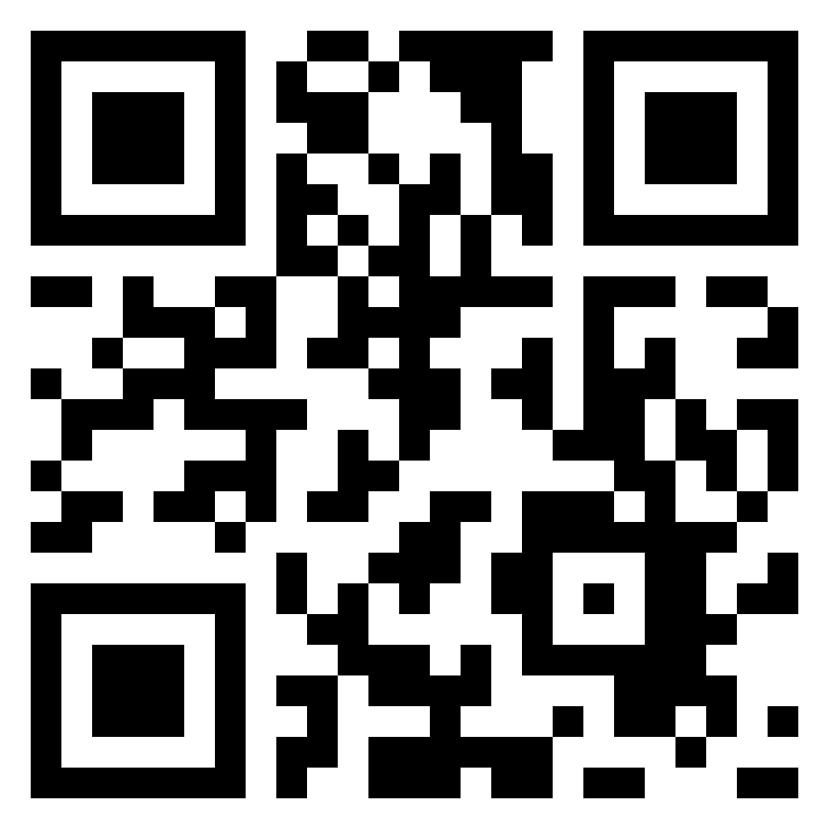
Thank You!
Teri K Whittington
Telephone: W (402) 915-3007 M (308) 325-2832
E-mail: Teri@envisionsuccessinc.com
Website: envisionsuccessinc.com

