Slide 1

Business Continuity Considerations
MICA 2023 Fall Business Meeting
Dyanne Ross-Hanson
Exit Planning Strategies, LLC

Slide 2

What is Business Continuity?
Continuity of:
  Ownership
  Leadership
  Operations
Notes:
2

Slide 3
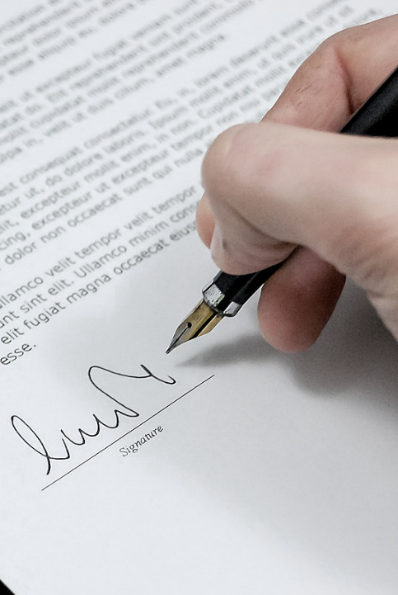
Multiple Owners
Ownership Issues
Buy Sell Agreement
The Single Most Important Business Document You Will Ever Sign

Slide 4

Ownership Continuity
Buy Sell Agreement – Patterns & Provisions
Who Should Buy?
The Death Buyout
When Disability Strikes
Lifetime Transfer Events
Third Party Offers
“Texas Shootout” Provision

Slide 5

Ownership Continuity
Buy Sell Agreement – Benefits
Creates a Ready Market - Predetermined
Assures Creditors, EE& Customers
Facilitates a Smooth Transition/Harmony
Provides Mutually Agreeable Terms/Price
Liquidity for Deceased Owner’s Family

Slide 6

Types of Buy-Sell Agreements
Entity Redemption
Cross Purchase
Partnership/LLC Purchase
One-Way Buy Sell

Slide 7

Hypothetical Case Study
ABC Insulation Inc.
Four Equal Owners:
Allison – 36: Jenna – 43: Jeremy – 51: Chad - 38
Subchapter S Corp
Growing & Profitable – 35 FT EE’s
Recent Company Valuation = $8M

Slide 8

Business Continuity
Funding Issues?
  Business Cash Flow
  Sinking Fund
  Bank Financing
  Life Insurance

Slide 9
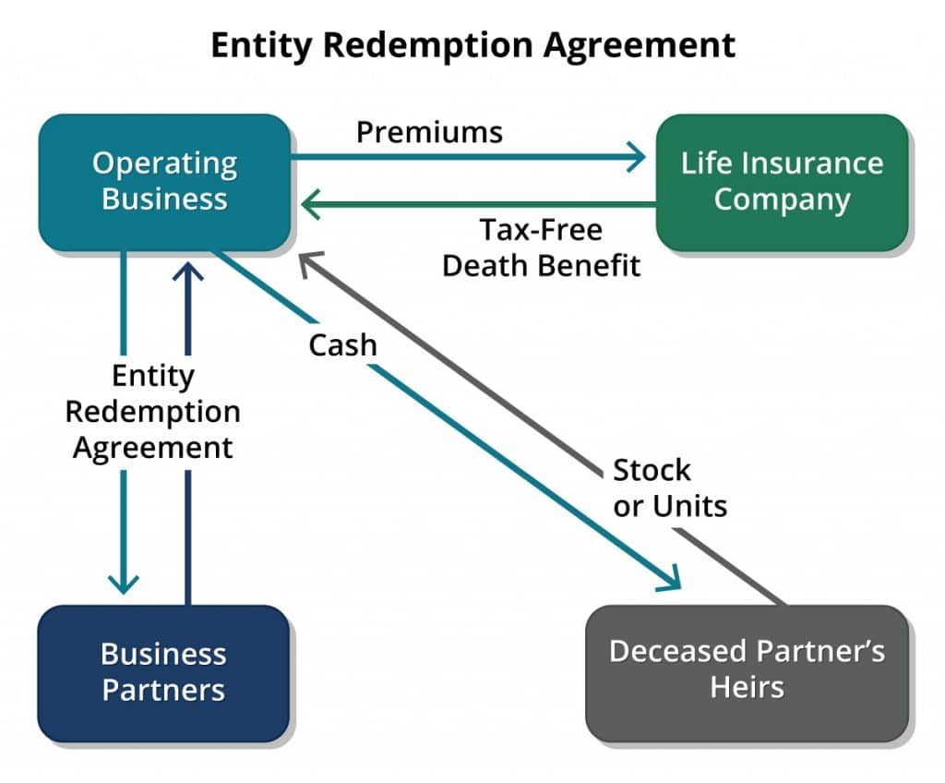

Slide 10
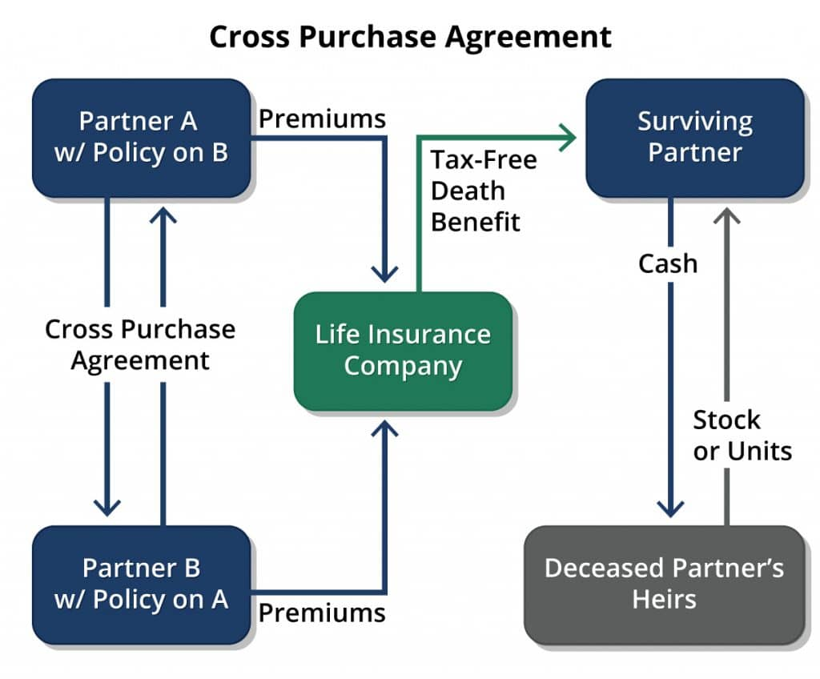

Slide 11
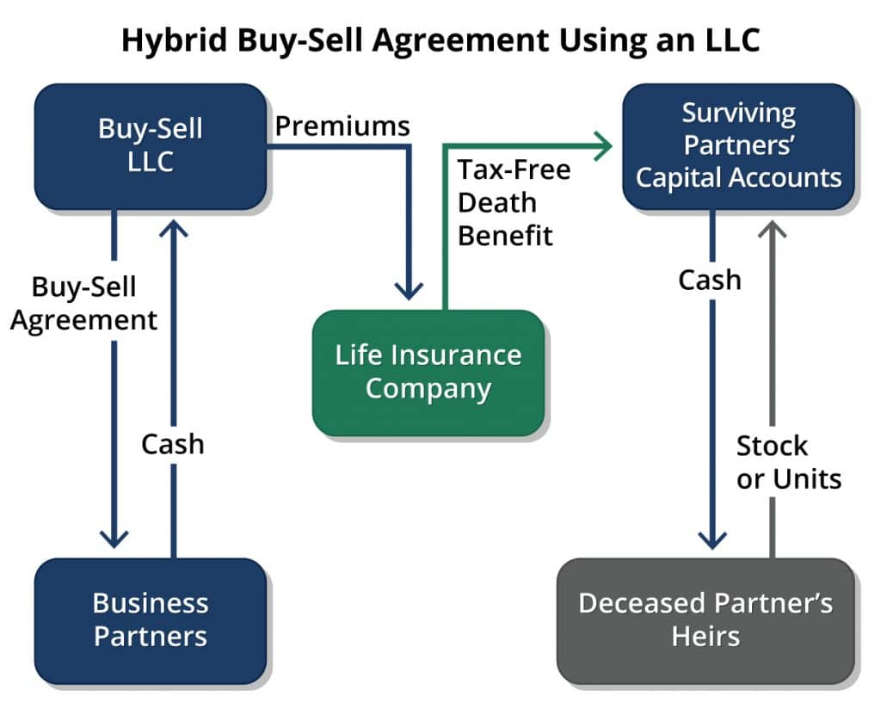

Slide 12
Cost Basis Adjustment - Example
Entity Stock Redemption l LLC/Partnership Arrangement
ABC Insulation Inc. Value = $8,000,000
4 Equal Owners: Allison - Jenna - Jeremy – Chad
Each Owner Insured for $2M Death Benefit.
Chad Dies:
Result:
Each shareholder’s interest has been adjusted from $2M to $2.67M value.
No Cost Basis Adjustment.
Upon sale – Capital Gain Tax Owed = $1,281,600
ABC Insulation Inc Valuation = $8,000,000
4 Equal Owners: Allison - Jenna - Jeremy – Chad
Each Owner Insured for $2M Death Benefit.
Chad Dies:
Result:
Each shareholder’s interest has been adjusted from $2M to $2.67M value.
Each Shareholder gets a Step Up in Cost Basis equal to $666,666.
Upon sale – Capital Gain Tax Owed = $1,004,800
2M to Co.
Co Buys Stock
3 Remining
2M to Partnership
Partnership Buys Stock
3 Partners Remain
Notes:
State Taxes on Capital Gains - varies depending on the state and the income level of the taxpayer
Some states tax income from investments and income from work at the same rate, while others tax capital gains less than ordinary income or not at all¹².
The highest state capital gains tax rate is 33 percent in California, and the lowest is 25 percent in the nine states with no personal income tax³⁴.
The average across all states is 28.7 percent⁴.
There are also three federal long-term capital gains tax brackets: 0 percent, 15 percent, and 20 percent⁵.
Example = 20% Federal + 28% State = 48%

Slide 13
Comparison of Buy-Sell Strategies
Consideration | Stock Redemption | Cross- Purchase | Partnership
Policy Owner | Company | Shareholders | Partnership
# of Policies | One Per Shareholder | N = # of Owners N x (N-1) | One Per Partner
Cost of Life Insurance | Proportionate to Ownership | Higher for Younger / Lower for Older Owners | May be Allocated as Desired
Change in Ownership Interests | Proportionate Adjustment | Permits Owners to Design Percentages | Permits Owners to Design Percentages
Alternative Minimum Tax (AMT) Considerations | Death Benefit MAY be Subject | Death Benefit NOT Subject | Death Benefit NOT Subject
Tax Basis Impact | Surviving Owners Basis Unchanged | Surviving Owners Step-Up in Basis | Surviving Owners Step-Up in Basis

Slide 14
One Way Buy Sell Agreement
Sole Owner’s Estate
Business Shares
Key Employee(s)
Cash
Insurance Co
Insured = BO
Owner = KE
Premium Paid via Bonus from Company

Slide 15

Loss of Key Person
Loss of Financial Resources
Loss of Key Talent
Solution: Key Person Life Insurance

Slide 16

Business Continuity: Sole Owner
Solution:
A “Stay Bonus”

Slide 17

Business Continuity
Four Vital Issues
Continuity of Business Ownership
Company’s Loss of Financial Resources
Loss Of Key Talent – The Owner
Loss Of Employees and Customers

Slide 18



Funding Sources
Company Cash Flow Bank Financing Life Insurance

Slide 19

Questions?
Dyanne Ross-Hanson
p. 651 426 0848
e. drh@exitplanstrategies.com
w. exitplanstrategies.com

